Slide 1
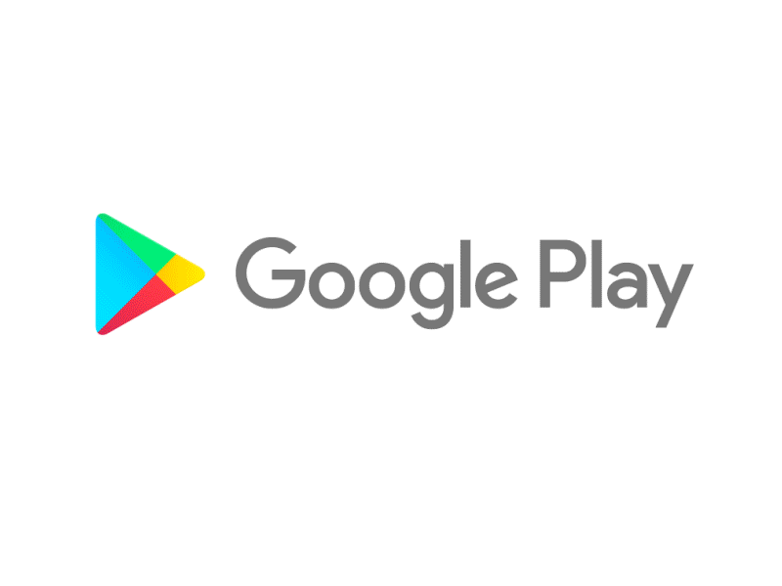
Capstone Project
Play Store App Review Analysis
By
Shreya Agrawal
Shubhangani Tiwari
Data Science Trainee, AlmaBetter

Slide 2






WHY ANALYZE THE GOOGLE PLAY STORE?
Mobile App Market is set to grow 20% by 2023
Android Apps comprise 90% of the Mobile App Market
What makes an App popular? Can we predict how popular it’s going to be?
What are some interesting patterns in user behavior related to app usage & feedback?

Slide 3


Introduction
There are more than 3.04 million apps found on Google Play Store.
The Play Store apps data has enormous potential to drive app-making businesses to success.
Actionable insights can be drawn for developers to work on and capture the Android market.

Slide 4
The objective of this project is to deliver insights to understand customer demands better and thus help developers to popularize the product. To clarify, the ‘popular’ in this project means a high number of installations.
The main goals of our project are-
to gather and analyze detailed information on apps in the Google Play Store in order to provide insights on app features and the current state of the Android app market.
to Explore and analyze the data to discover key factors responsible for app engagement and success.

Slide 5


Problem Statement
Problem Statement
Two datasets are provided, one with basic information and the other with user reviews for the respective app.
We must examine and evaluate the data in both datasets in order to identify the important characteristics that inﬂuence app engagement and success.
So, what factors inﬂuence an app's success?
An app is said to be successful if it has:
A high average user rating
A good number of positive reviews
A good number of installs

Slide 6

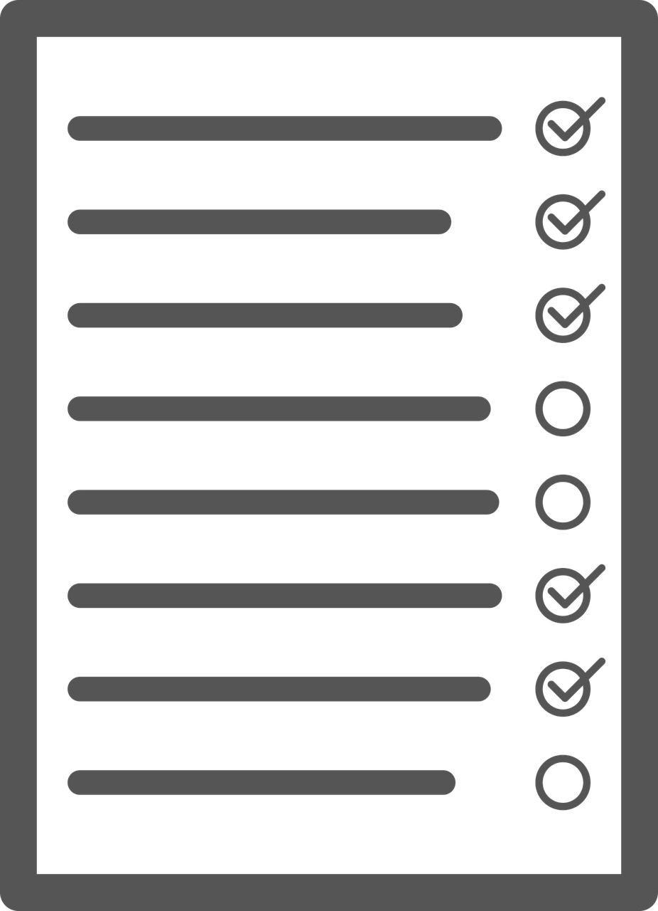
Agenda
Introduction
Category wise play store apps installs
Category wise most popular apps
Top 10 apps in play store considering all the parameters
Average installs, category wise
Most installed apps in communication category
Average sizes of apps in each category
Category wise percentage of paid apps
Category wise top installed paid apps
Average rating of paid apps
Correlation between Rating ,Installs and Price
Category wise installed apps with content rating
Percentage reviews sentiment distribution

Slide 7

Dataset Preparation
Loading the data sets: Two datasets, First Play store app
dataset and User Reviews dataset.
Import Libraries: NumPy, Pandas, Seaborn and Matplotlib
Data cleaning: Null values, Finding and removing Outliers, Removing duplicate data.
Data Imputation: Filling the missing categorical values with mode and numerical values with median. Conversion of price, installs, reviews into numerical values.
Exploratory Data Analysis: Analyzing the data sets to summarize their main characteristics using statistical graphics and data visualizations method.

Slide 8
1.App : This column Contains the name of the app for each observation. 2.Category : This column Contains Category to which the app belongs. 3.Rating : This column contains the average rating for the app. 4.Reviews : This column contains the number of reviews that the app has received on the play store. 5.Size : This column contains the amount of memory the app occupies on the device. 6.Installs : This column contains the number of times that the app has been downloaded and installed from the play store. 7.Type : This column contains the information whether the app is free or paid. 8.Price: If the app is a paid app, this column contains the data about its price. 9.Content Rating: This column contains the maturity rating of the app i.e. the age group of the audience for which it is suitable. 10.Genres: This column contains the data about to which genre the app belongs. Genres can be considered as a further division of the group of Category. 11.Last Updated: Contains the date on which the latest update of the app was released. 12.Current Version: Contains information on the current version of the app available on the play store. 13.Android Version: Contains information about the android versions on which the app is supported.
Attributes in Google Play store Data

Slide 9

Attributes in User reviews
App- Application name
Translated Review- User review
Sentiment- Positive/Negative/Neutral
Sentiment Polarity- Sentiment polarity score
Sentiment Subjectivity- Sentiment subjectivity score

Slide 10



OVERVIEW OF ANALYSIS
Data Cleaning
Data Exploration
Predictive Modeling
Understand the structure of the dataset and clean data before analysis
Uncover initial patterns, characteristics, and points of interest using visual exploration
Formulate a statistical model to forecast an outcome using relevant predictors

Slide 11
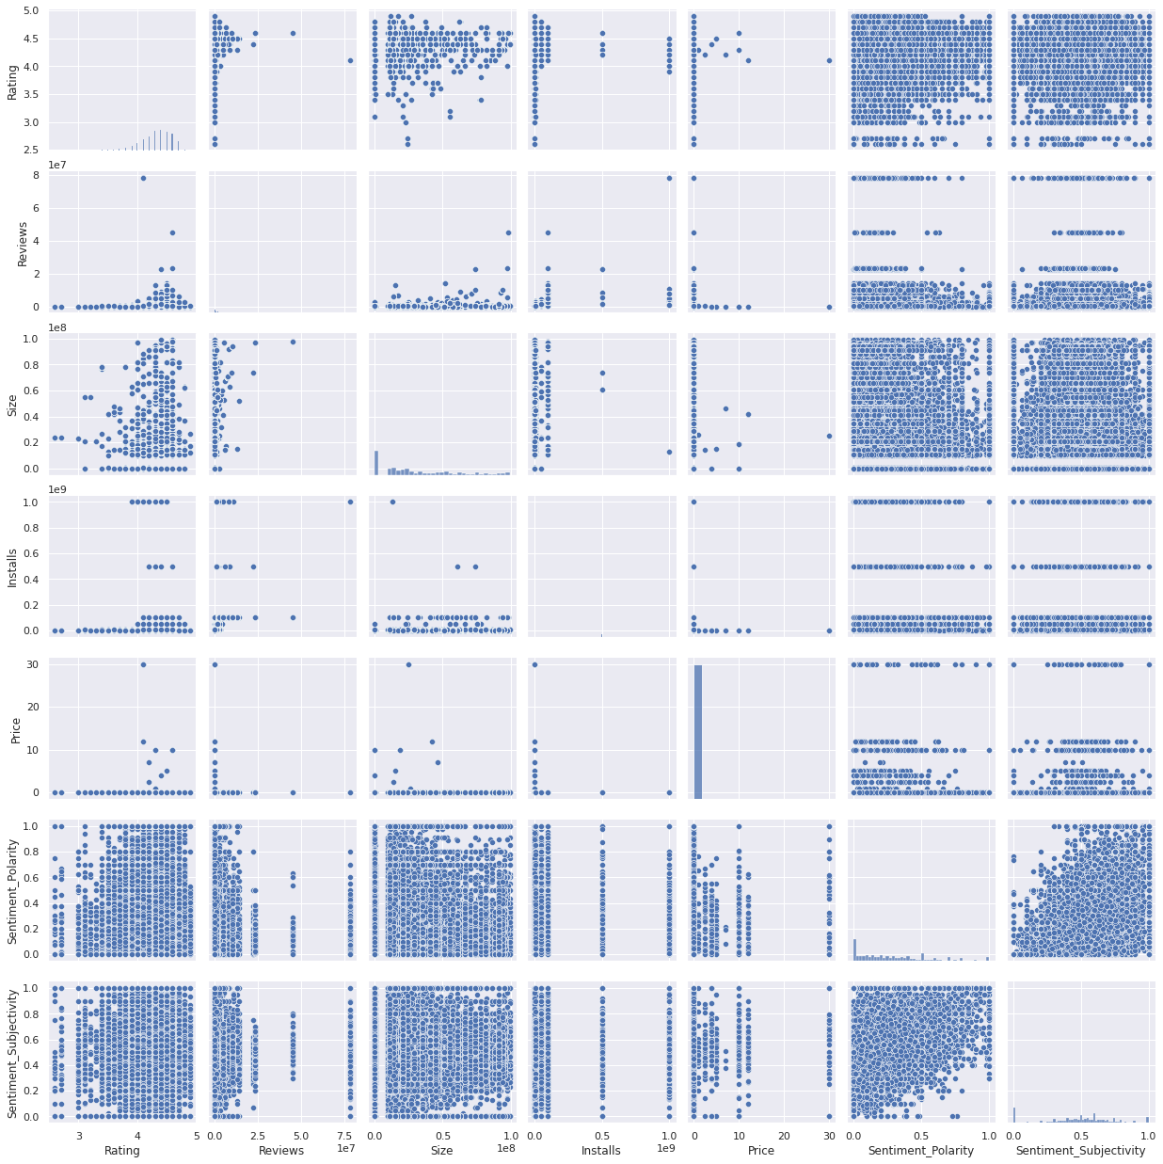
Pairwise Plot for all Numerical Variables:
Ratings.
Reviews.
Size.
Installs.
Price.
Sentiment Polarity.
Sentiment Subjectivity.

Slide 12
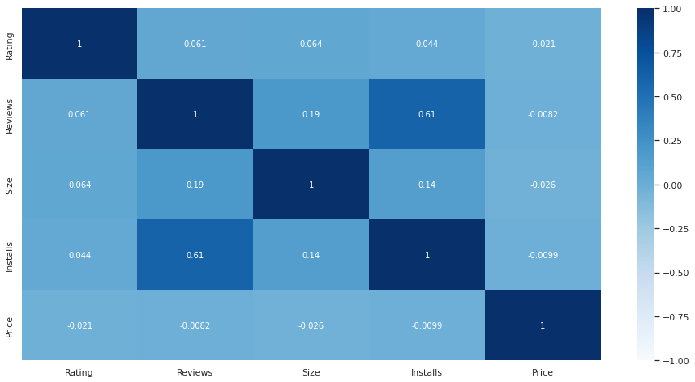
Correlation Heatmap
❏ There is a strong positive correlation between the Reviews and Installs.
❏ The Price is slightly
negatively correlated with
and
the Rating, Reviews, Installs.
❏ The Rating is slightly positively correlated with the Installs and Reviews.

Slide 13
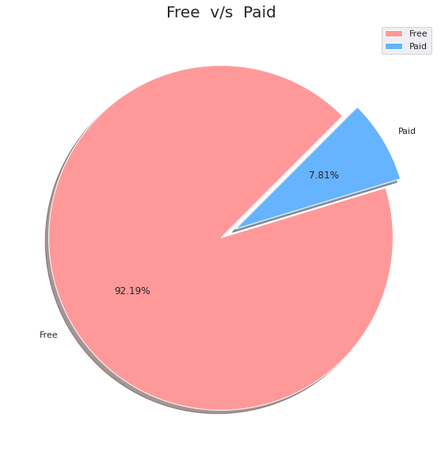

Percentage of Paid apps v/s Free apps
We Observed that 92.19% of Apps are free and only 7.81% of Apps are paid in Play store.

Slide 14
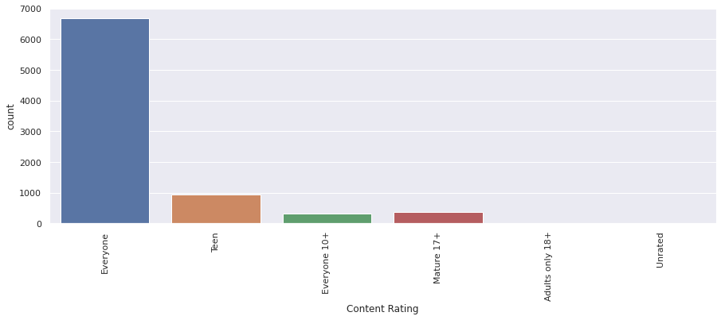
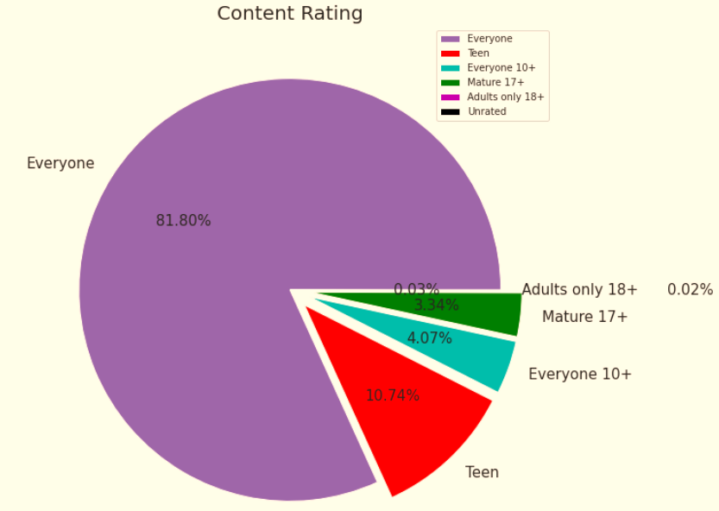
Content Rating
From the above plot, we can see that Everyone category having majority of apps count.
A majority of the apps (81.80%) in the play store can be used by everyone. The remaining apps have various age restrictions to use it.

Slide 15
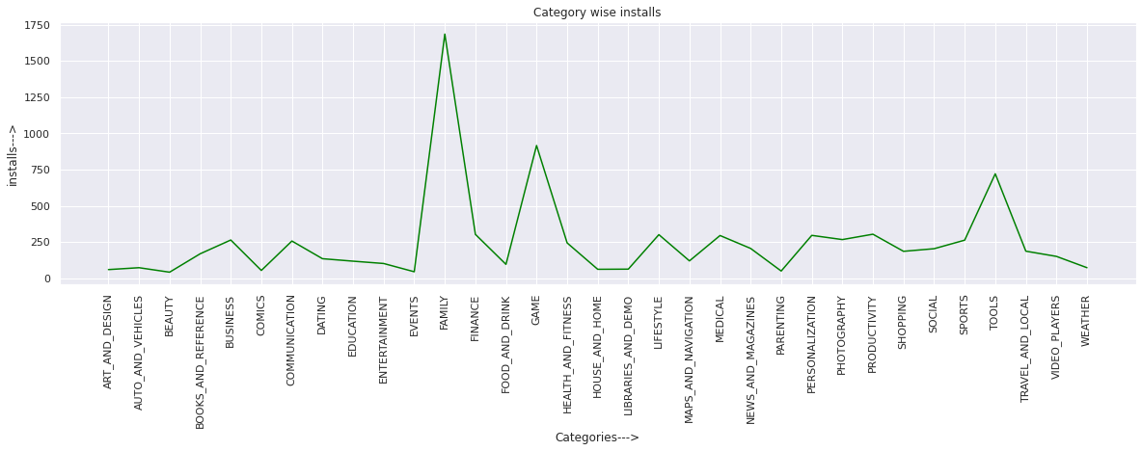
Category App's have most number of installs
Categories with the most no. of installs are:
Category | No. of Installs
FAMILY | 1685
GAME | 916
TOOLS | 721
PRODUCTIVITY | 304
FINANCE | 303

Slide 16
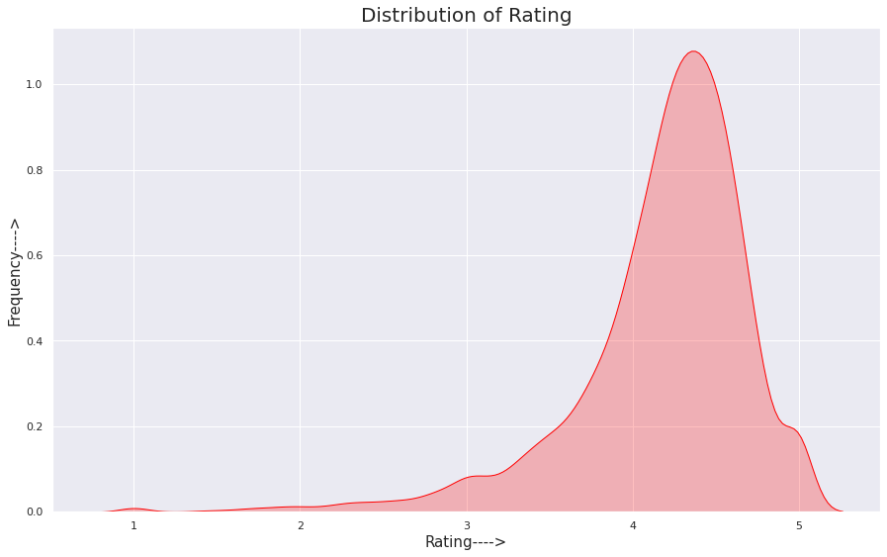
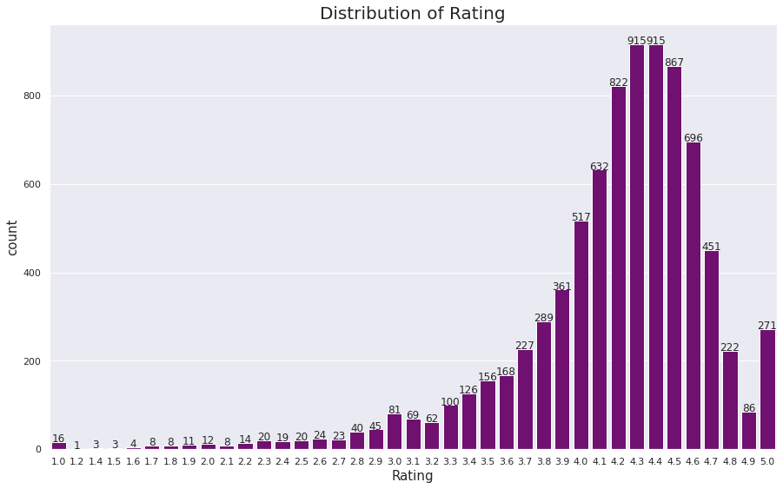
Distribution of Rating of Apps
The majority of the apps in the Play Store are top rated.
This implies that the majority of the users are happy with the services received via the respective app.

Slide 17
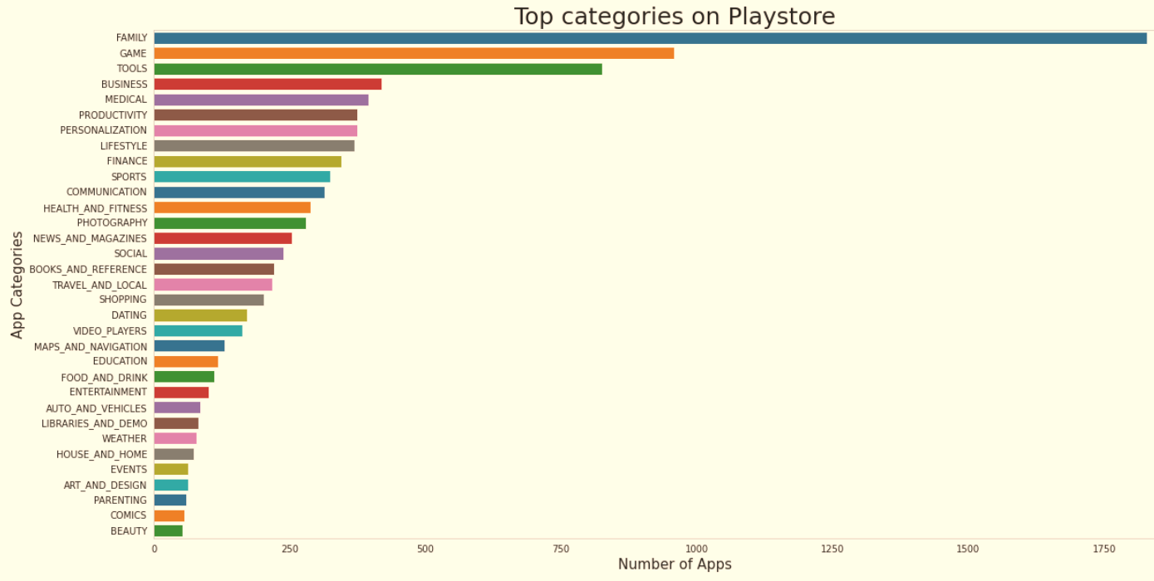
Count of Applications in each category
Family and Game apps have the
highest market prevalence. Surprising Tools, Business and Medical apps are also at the Top Count of applications.

Slide 18
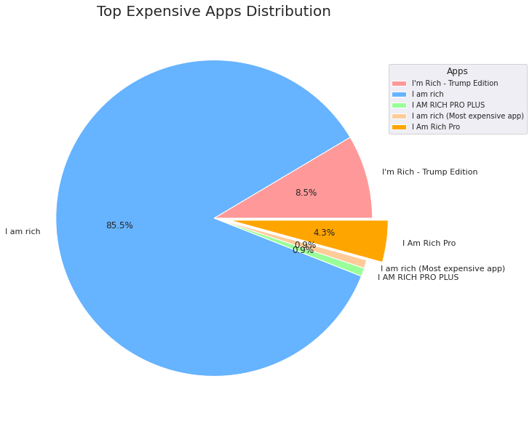
Top Expensive Apps
Findings:
From the above graph, we can interpret that “I am Rich“ app is the most expensive app in Play Store.

Slide 19
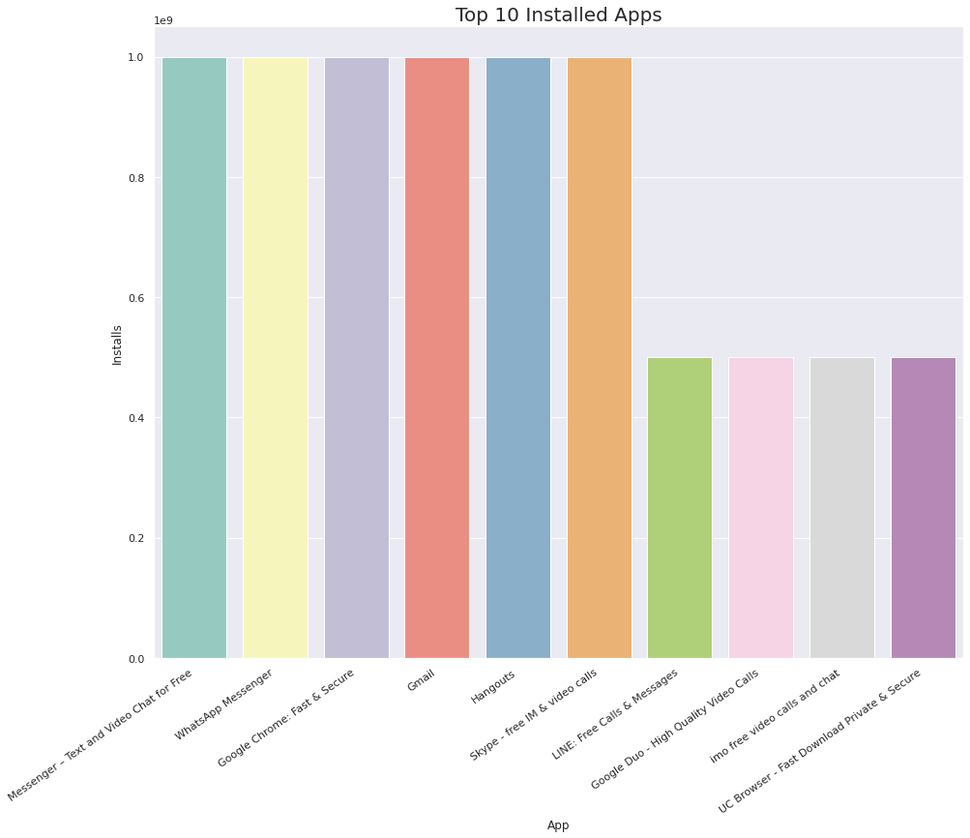
Top 10 installed apps in any category
findtop10incategory('Communication')
This graph shows the top installed apps in the ‘Communication’ category .
Messenger,
WhatsApp,
Google Chrome,
Gmail have the
highest installs.
In the same way, by passing different category names in the function findtop10incategory(str),we can get the top 10 installed apps for respective category.

Slide 20
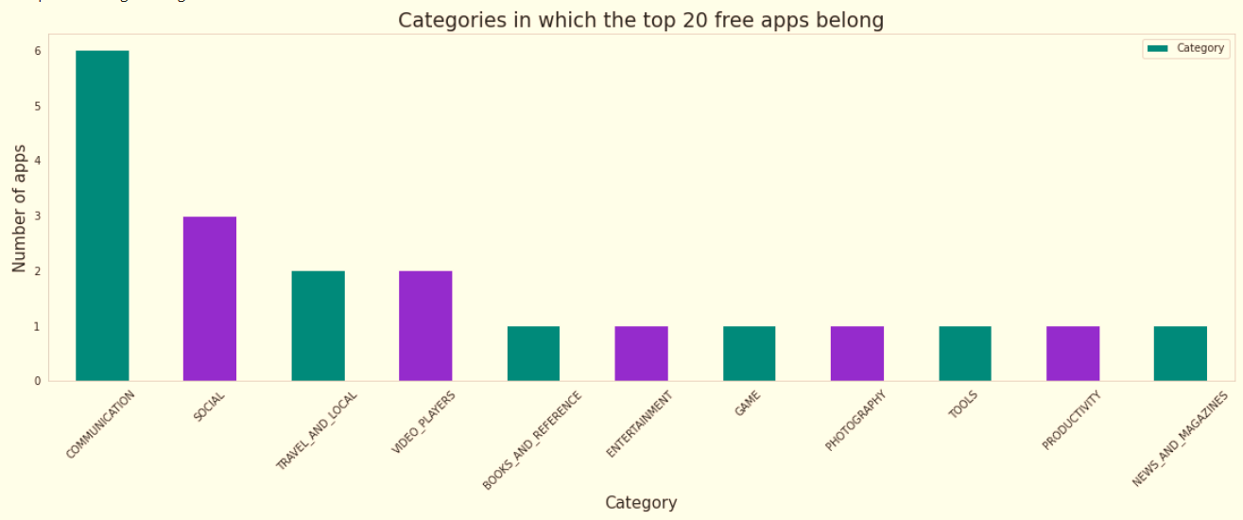
Top Free Apps
There are a total of 20 free apps with over one billion installs.
The top categories in which these apps fall are Communication(6), Social(3), Video Players(2), Travel and Local(2).

Slide 21
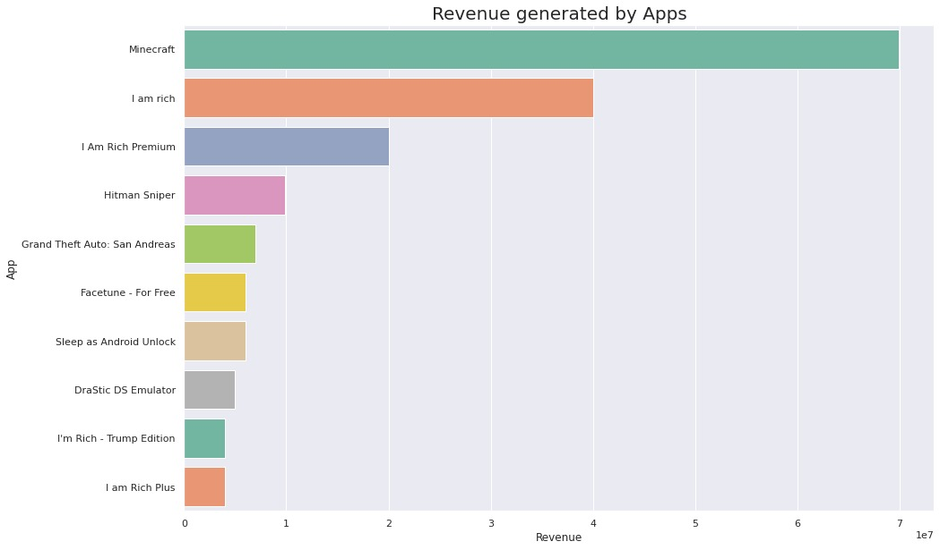
Top Paid Apps Based on Revenue Generated
Revenue generated is given by the formula:
Revenue = Installs * Price
Note that in this case, revenue refers to the money earned only from paid app installs.
Minecraft, I am rich, and I am rich premium are the top paid apps based on revenue generated.
The top categories in which these apps fall are Lifestyle(5), Family(5), and Game(4).

Slide 22
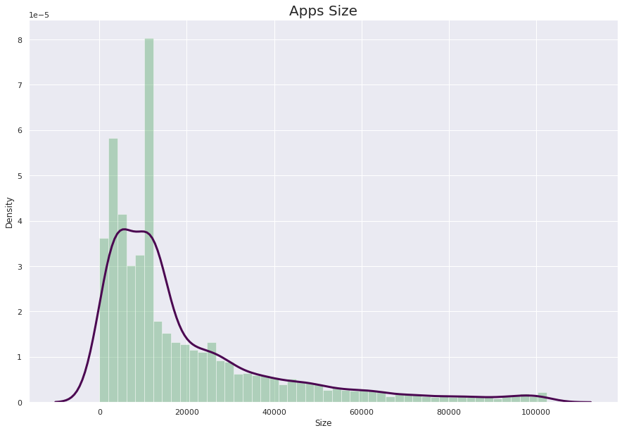

App Size Analysis
Summary:
This Distribution Plot shows that sizes of
most of the apps in playstore are between 0kb to 20000kb.

Slide 23
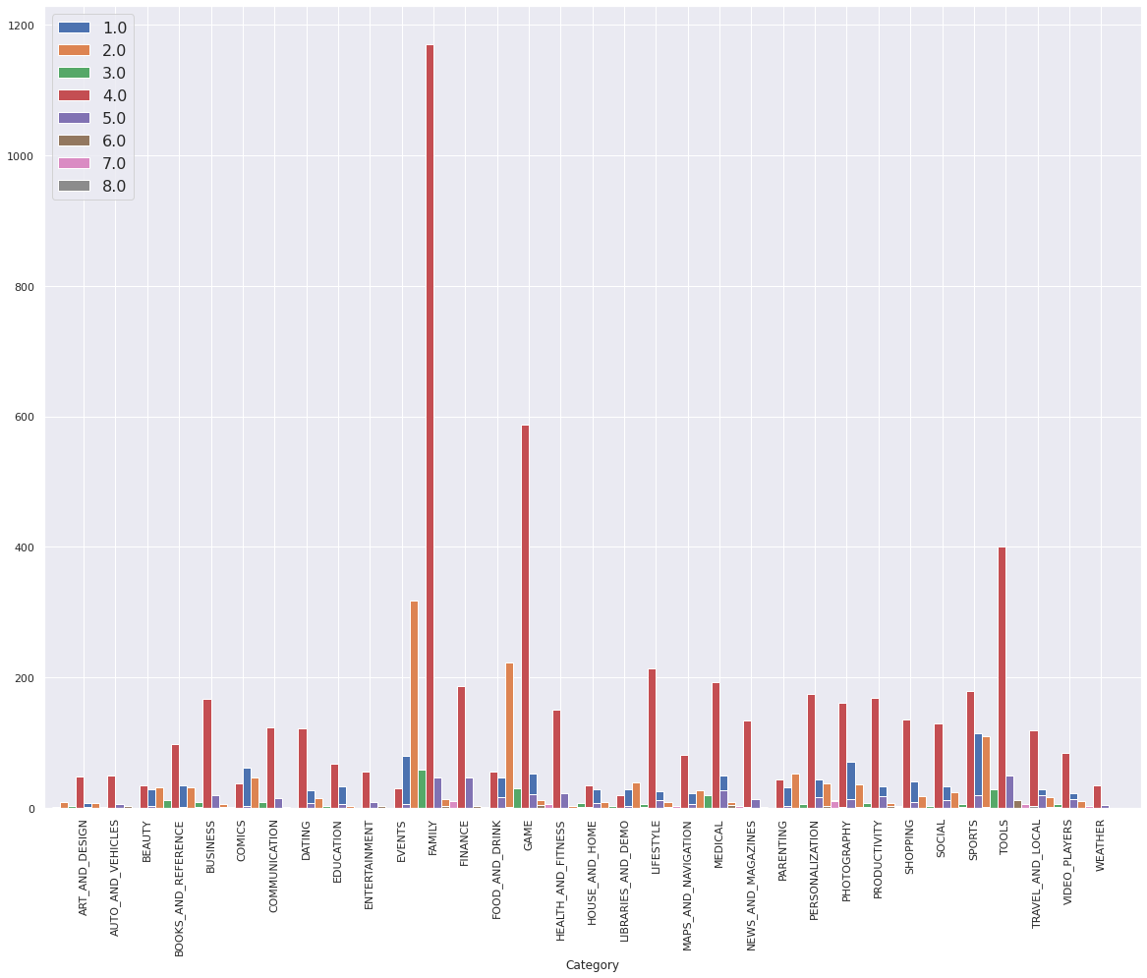
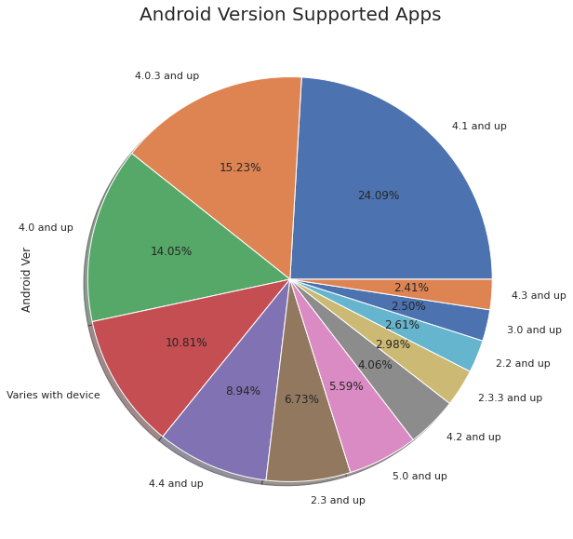
Android version based on each category
Android version 4.0 and above supported apps is very higher and more than 60% of total app support.

Slide 24
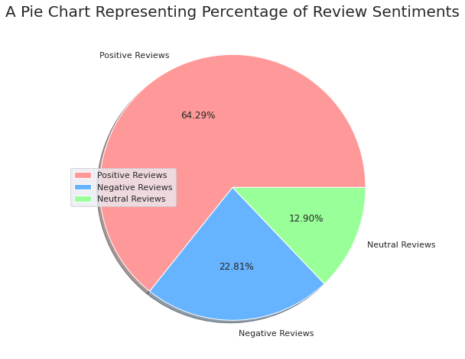
Percentage of Review Sentiments
The number of Unique Apps from Play store and User reviews merged dataset are 816.
From Sentiment column, 64% are Positive, 23% are Negative and 13% are Neutral values.

Slide 25
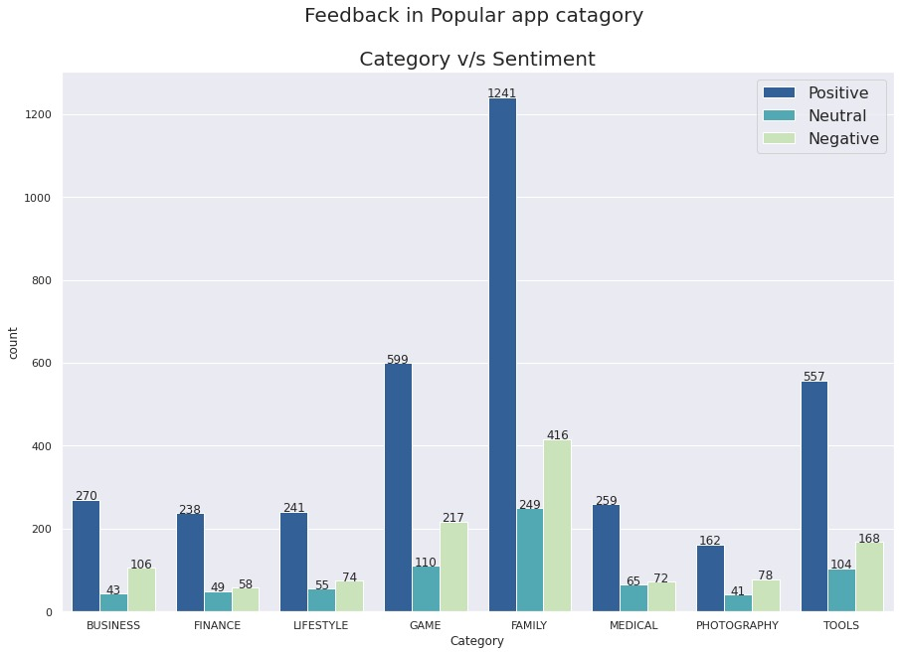
Feedback in Popular Category:
This Visualisation is for Positive , Negative and Neutral sentiments for popular categories.
RESULT:
Chart shows that each category have the larger number of positive sentiments than negative and neutral sentiments.

Slide 26
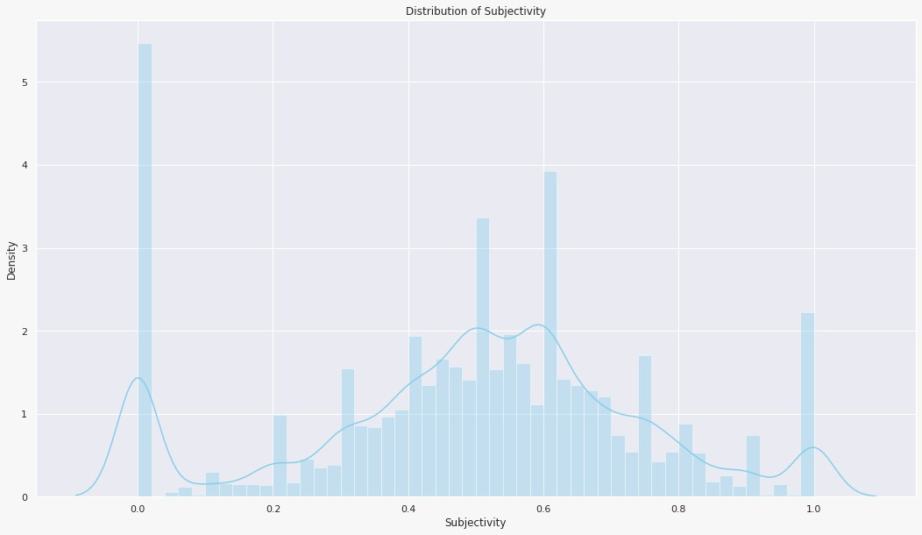
Distribution of Sentiment Subjectivity:
Findings:
0 - objective(fact)
1 - subjective(opinion)
It can be seen that maximum number of sentiment subjectivity lies between 0.4 to 0.7. From this we can conclude that maximum number of users give reviews to the applications, according to their experience.

Slide 27
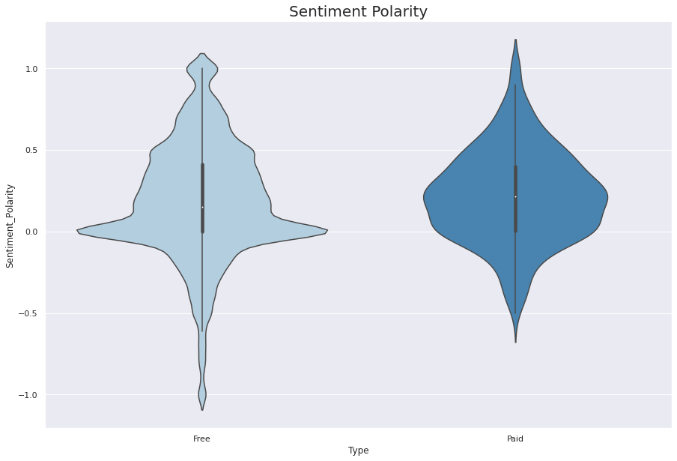
Sentiment_Polarity relation with paid and Free App:
This Violinplot shows that density of neutral sentiment polarity is high for both type of app.
Chances of Negative Sentiment Polarity is less for paid apps in comparison to Free apps.
⏩
⏪

Slide 28
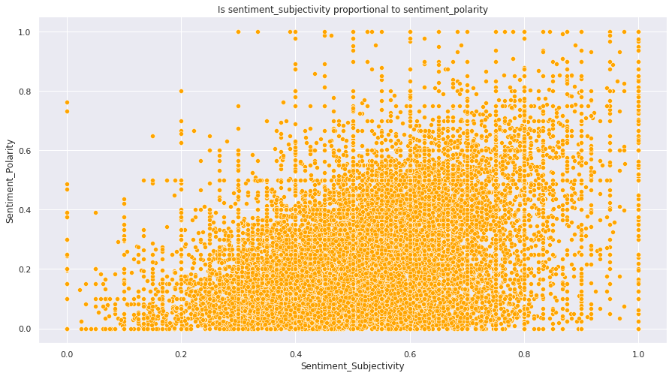
Is sentiment_subjectivity proportional to sentiment_polarity?
From the above scatter plot it can be concluded that sentiment subjectivity is not always proportional to sentiment polarity but in maximum number of case, shows a proportional behavior, when variance is too high or low.

Slide 29
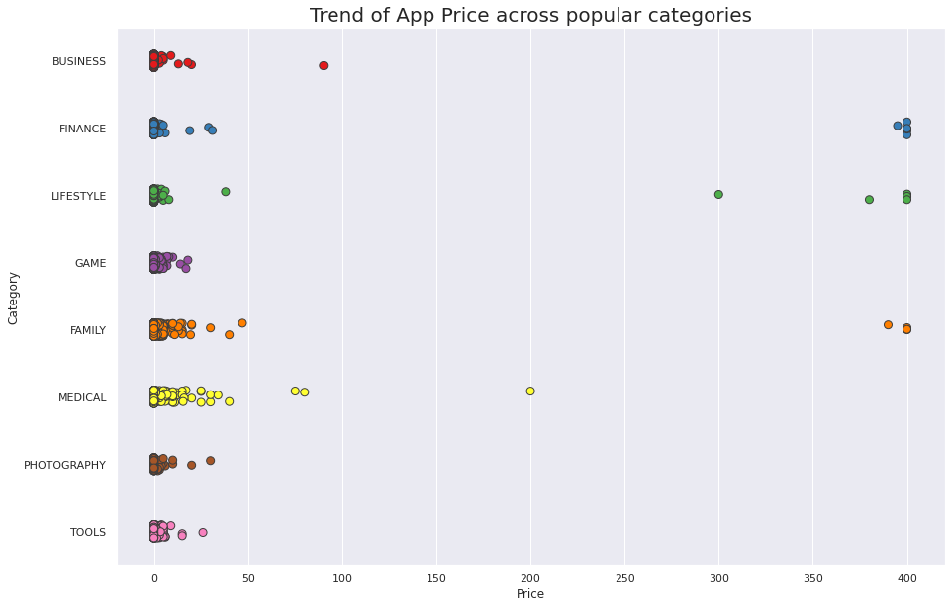
App Prices across the Popular Categories:
Our insights from this plot:
👇
From this stripplot between price and category we infer that most of the apps on playstore are available for free.
And very few categories provide the apps of paid type and maximum price of any app is not exceeding the $400.

Slide 30
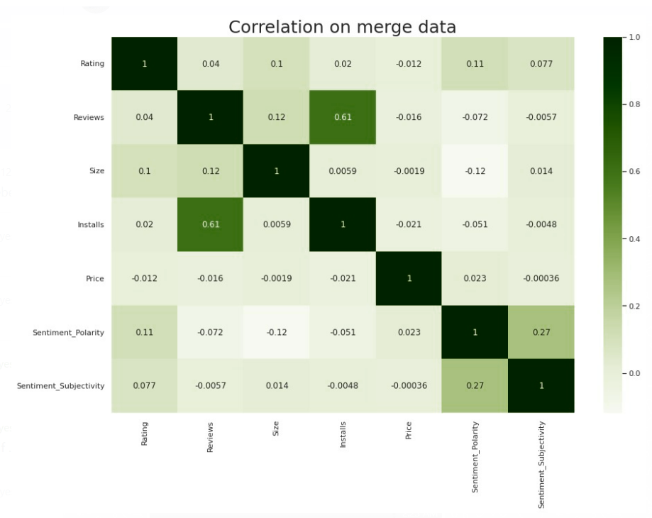
Co-Relation in merged data frame
In this correlation matrix, There is not a significant relationship between Rating, Reviews, Size and Installs with respect to the Sentiment polarity and Sentiment subjectivity.

Slide 31
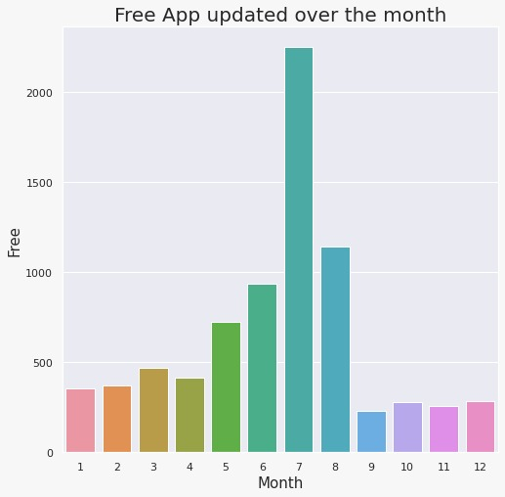
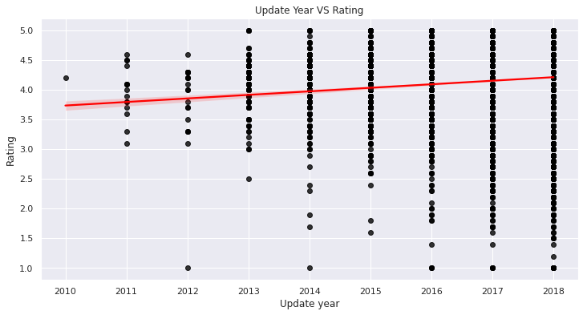
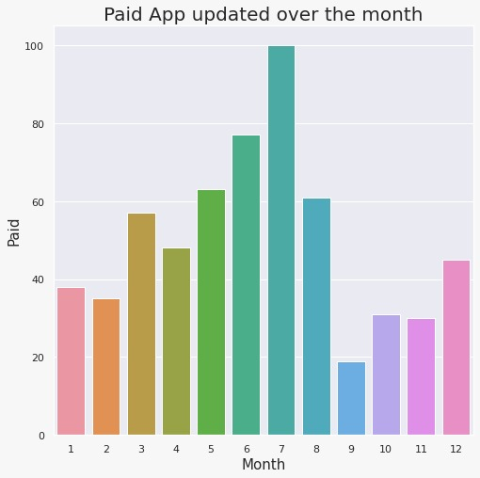
Distribution of Apps updated over the Year and Month
Graph shows that the recently updated apps have more chances of getting high ratings…
👆

Slide 32

Challenges Faced
Challenges Faced
Reading the dataset and comprehending the problem statement.
Examining the business KPIs for app development and devising a solution to the problem.
Handling the error, duplicate and NaN values in the dataset.
Designing multiple visualizations to summarize the information in the dataset and successfully communicate the results and trends to the reader.

Slide 33
Conclusion’s
92.19% apps are Free and 7.81% apps are paid in type.
81.80% apps have Everyone content rating.
Events category has a highest mean rating of 4.39 and Dating category has lowest 4.05 rating.
Family, Game and Tools are top three categories having 1906, 926 and 829 app count.
Most competitive category: Family
Category with the highest number of installs: Game
Tools, Entertainment, Education, Business and Medical are top Genres.
8783 Apps are having size less than or equal to 50 MB.
7749 Apps has rating more than 4.0 including both type of app.
Overall sentiment count of merged dataset in which Positive sentiment count is 64%, Negative 22% and Neutral 14%.

Slide 34
Conclusion’s
It's good to develop a Free type app and having a content rating for Everyone.
Percentage of apps that are top rated = 81.80%
There are 20 free apps that have been installed over a billion times
Minecraft is the only app in the paid category with over 10M installs, and also has produced the most revenue only from installation fee.
Price, Rating, Size has no or very less correlation with Sentiment Polarity.
The median size of the apps in the play store is 12 MB
The apps whose size varies with device has the highest number average app installs.
The apps whose size is greater than 90 MB has the highest number of average user reviews, ie, they are more popular than the rest.
Helix Jump has the highest number of positive reviews and Angry Birds Classic has the highest number of negative reviews.

Slide 35


